Slide 1

ECE 2700
Digital Circuits
Exam I Review
Copyright © 2010 Frank Vahid
Instructors of courses requiring Vahid's Digital Design textbook (published by John Wiley and Sons) have permission to modify and use these slides for customary course-related activities, subject to keeping this copyright notice in place and unmodified. These slides may be posted as unanimated pdf versions on publicly-accessible course websites.. PowerPoint source (or pdf with animations) may not be posted to publicly-accessible websites, but may be posted for students on internal protected sites or distributed directly to students by other electronic means. Instructors may make printouts of the slides available to students for a reasonable photocopying charge, without incurring royalties. Any other use requires explicit permission. Instructors may obtain PowerPoint source or obtain special use permissions from Wiley – see http://www.ddvahid.com for information.

Slide 2
Decoders
Inputs: n bits, outputs: 2^{n} elements
Converts input binary number to one high output
2-input decoder: four possible input binary numbers
  So has four outputs, one for each possible input binary number
Decoders can have an enable bit e
  If e = 1, all outputs are 0, regardless of i0 and i1
d0
1
d0
0
d0
0
d0
0
0
i1
d1
0
0
i1
d1
1
1
i1
d1
0
1
i1
d1
0
0
i0
d2
0
1
i0
d2
0
0
i0
d2
1
1
i1
d2
0
d3
0
d3
0
d3
0
d3
1

Slide 3
Decoders
Decoders are sometimes called minterm generators
  For each input combination, exactly one output is true
  Each output equation contains all of the input variables
  These properties hold for all sizes of decoders
So you can implement arbitrary functions with decoders
i1 | i0 | d0 | d1 | d2 | d3
0 | 0 | 1 | 0 | 0 | 0
0 | 1 | 0 | 1 | 0 | 0
1 | 0 | 0 | 0 | 1 | 0
1 | 1 | 0 | 0 | 0 | 1
d0 = i1’ i0’
d1 = i1’ i0
d2 = i1 i0’
d3 = i1 i0

Slide 4
Decoder Example
Consider a 2x4 decoder with enable where
  i1, i0, and e are the input bits
  d3, d2, d1, d0 are the output bits
If d3 = 1, d2 = 1, d1 = 0, and d0 = 0, what are the values for i1 and i0?

Slide 5
Decoder Example
Let’s make a circuit that adds three inputs X, Y, Z
We will need two bits to represent the total
  Let’s call them C and S, for “carry” and “sum”
X | Y | Z | C | S
0 | 0 | 0 | 0 | 0
0 | 0 | 1 | 0 | 1
0 | 1 | 0 | 0 | 1
0 | 1 | 1 | 1 | 0
1 | 0 | 0 | 0 | 1
1 | 0 | 1 | 1 | 0
1 | 1 | 0 | 1 | 0
1 | 1 | 1 | 1 | 1
C = X’YZ + XY’Z + XYZ’ + XYZ
S = X’Y’Z + X’YZ’ + XY’Z’ + XYZ
0 + 1 + 1 = 10
How do you build this circuit using decoders and some logic gates?

Slide 6
Muxes: Concepts
They give you choices
  2x1, 4x1, 8x1, 16x1 muxes and so on
  The number of select bits is log₂n
i0
0000
4
⋅
1
4
⋅
1
0000
0
i0
i3
i1
0110
i1
1
i2
d
1111
d
1
d
i2
1
i1
i2
1110
i3
1
i0
s1
s0
s1
s0
i3
0
0
0
1
4-bit 4x1 mux
1-bit 4x1 mux
s1
s0

Slide 7
Mux Example
Build the circuit represented by the following truth table using a 2x1 mux
a
a | b | F
0 | 0 | 1
0 | 1 | 0
1 | 0 | 0
1 | 1 | 1
i₀ = b’
s0
F
i₁ = b

Slide 8
Encoder Concepts
Converts one of 2^{n} inputs to an n-bit output
  One of 2^{n} inputs = 1
  Output is an n-bit binary number
Inputs
Outputs
I
0
I
1
I
2
I
3
I
4
I
5
I
6
I
7
y₂
y₁
y₀
Binary
encoder
1
0
0
0
0
0
0
0
0
0
0
2^{n}
inputs
n
outputs
0
1
0
0
0
0
0
0
0
0
1
.
.
.
.
.
.
0
0
1
0
0
0
0
0
0
1
0
0
0
0
1
0
0
0
0
0
1
1
0
0
0
0
1
0
0
0
1
0
0
0
0
0
0
0
1
0
0
1
0
1
0
0
0
0
0
0
1
0
1
1
0
0
0
0
0
0
0
0
1
1
1
1

Slide 9
Encoder Implementation
Inputs
Outputs
I
0
I
1
I
2
I
3
I
4
I
5
I
6
I
7
y₂
y₁
y₀
1
0
0
0
0
0
0
0
0
0
0
0
1
0
0
0
0
0
0
0
0
1
0
0
1
0
0
0
0
0
0
1
0
0
0
0
1
0
0
0
0
0
1
1
0
0
0
0
1
0
0
0
1
0
0
0
0
0
0
0
1
0
0
1
0
1
0
0
0
0
0
0
1
0
1
1
0
0
0
0
0
0
0
0
1
1
1
1
I₀
I₁
I₂
I₃
I₄
I₅
I₆
I₇
y₂ = I₄ + I₅ + I₆ + I₇
y₁ = I₂ + I₃ + I₆ + I₇
y₀ = I₁ + I₃ + I₅ + I₇

Slide 10
Priority Encoder Concepts
What if more than one input line has a value of 1
  Ignore “lower priority” inputs
  Valid indicates that no input is 1
Inputs
Outputs
I
0
I
1
I
2
I
3
I
4
I
5
I
6
I
7
y₂
y₁
y₀
Valid
0
1
1
1
1
1
1
1
1
0
0
0
0
0
0
0
0
X
X
X
1
0
0
0
0
0
0
0
0
0
0
X
1
0
0
0
0
0
0
0
0
1
X
X
1
0
0
0
0
0
0
1
0
X
X
X
1
0
0
0
0
0
1
1
X
X
X
X
1
0
0
0
1
0
0
X
X
X
X
X
1
0
0
1
0
1
X
X
X
X
X
X
1
0
1
1
0
X
X
X
X
X
X
X
1
1
1
1

Slide 11
Priority Encoder Implementation
Inputs
Outputs
I
0
I
1
I
2
I
3
I
4
I
5
I
6
I
7
y₂
y₁
y₀
Valid
0
1
1
1
1
1
1
1
1
0
0
0
0
0
0
0
0
X
X
X
1
0
0
0
0
0
0
0
0
0
0
X
1
0
0
0
0
0
0
0
0
1
X
X
1
0
0
0
0
0
0
1
0
X
X
X
1
0
0
0
0
0
1
1
X
X
X
X
1
0
0
0
1
0
0
X
X
X
X
X
1
0
0
1
0
1
X
X
X
X
X
X
1
0
1
1
0
X
X
X
X
X
X
X
1
1
1
1
y₂ = i₇ + i₇’ i₆ + i₇’ i₆’ i₅ + i₇’ i₆’ i₅’ i₄
y₁ = i₇ + i₇’ i₆ + i₇’ i₆’ i₅’ i₄’ i₃ + i₇’ i₆’ i₅’ i₄’ i₃’ i₂
y₀ = …
Valid = i₇ + i₆ + i₅ + i₄ + i₃ + i₂ + i₁ + i₀

Slide 12
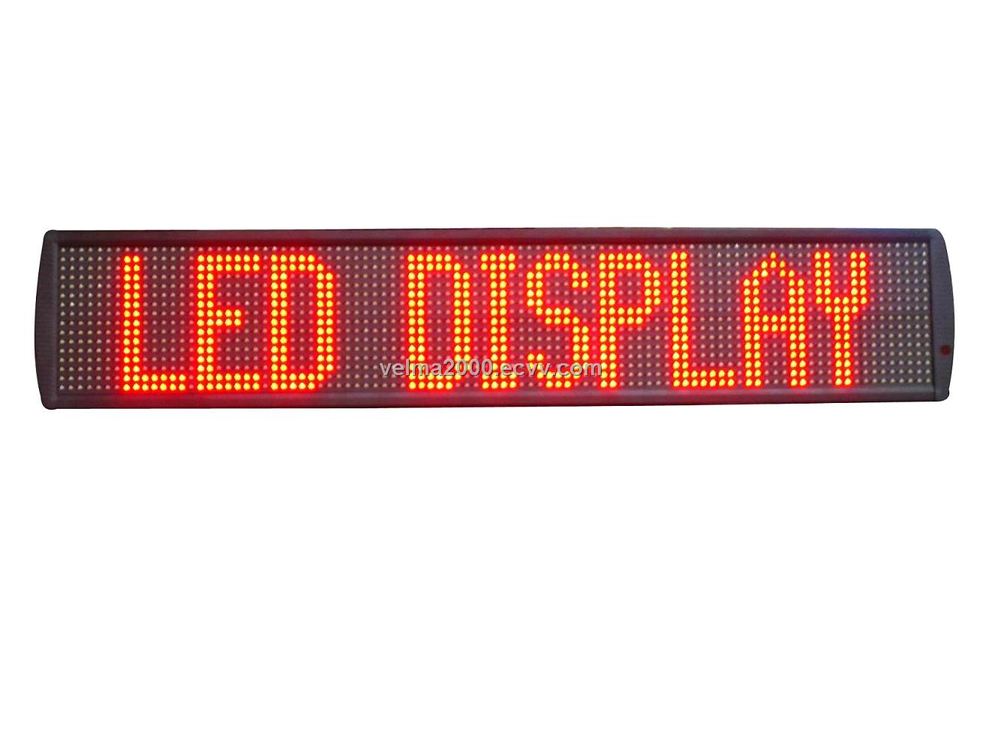
Encoder Design Example
Design the following system
  I give you a math problem and divide the class into 6 groups. Each group inputs their response into a data collection system. I want to see the response of a group at any given time
Inputs from student
groups (their responses)
I can decide the
response to display
1
i7
i5
i0
8x1 mux
1
0
1
Group 1
0
0
0
0
0
1
0
0
e
8x3
enc
i0
Group 2
d0
…
d2
Group 6
i5
Not used
Not used
i7

Slide 13
Gates & Their Complements
NOT
AND
  Cookies and milk
  Complement: NAND (not AND)
OR
  Cookies or milk
  Complement: NOR (not OR)
XOR
  Either I’m going to have cookies or I’m going to have milk
  Complement: XNOR (not XOR)

Slide 14
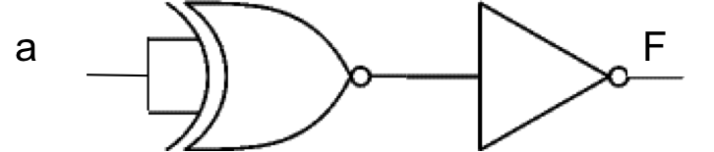
Gate Example
What is the corresponding Boolean expression for F?
The first gate is XNOR. a XNOR a = 1 regardless of the value of a
  XNOR detects equality
Then, we have an inverter so F = 0

Slide 15
Gate Example
Which logic gate does F represent?
  F = a’ + ab’
F = 1 when a = 0 or when a = 1 and b = 0
  In other words, F = 0 when a = 1 and b = 1
  This corresponds to a NAND gate

Slide 16
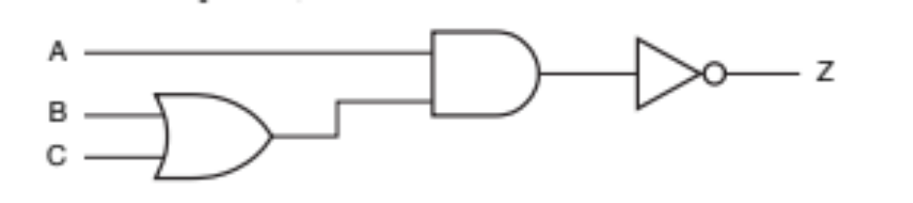

Gate Example
Redraw the following circuit using only NAND gates
Can you do the same for NOR gates?
A
Z
B
C

Slide 17
XOR – Detecting Odd # of 1’s
a | b | c | d | # of 1’s | a b | c d | a b c d
0 | 0 | 0 | 0 | 0 | 0 | 0 | 0
0 | 0 | 0 | 1 | 1 | 0 | 1 | 1
0 | 0 | 1 | 0 | 1 | 0 | 1 | 1
0 | 0 | 1 | 1 | 2 | 0 | 0 | 0
0 | 1 | 0 | 0 | 1 | 1 | 0 | 1
0 | 1 | 0 | 1 | 2 | 1 | 1 | 0
0 | 1 | 1 | 0 | 2 | 1 | 1 | 0
0 | 1 | 1 | 1 | 3 | 1 | 0 | 1
1 | 0 | 0 | 0 | 1 | 1 | 0 | 1
1 | 0 | 0 | 1 | 2 | 1 | 1 | 0
1 | 0 | 1 | 0 | 2 | 1 | 1 | 0
1 | 0 | 1 | 1 | 3 | 1 | 0 | 1
1 | 1 | 0 | 0 | 2 | 0 | 0 | 0
1 | 1 | 0 | 1 | 3 | 0 | 1 | 1
1 | 1 | 1 | 0 | 3 | 0 | 1 | 1
1 | 1 | 1 | 1 | 4 | 0 | 0 | 0

Slide 18
XNOR – Detecting Even # of 1’s
a | b | c | d | # of 1’s | a b | c d | (a b c d)’
0 | 0 | 0 | 0 | 0 | 0 | 0 | 1
0 | 0 | 0 | 1 | 1 | 0 | 1 | 0
0 | 0 | 1 | 0 | 1 | 0 | 1 | 0
0 | 0 | 1 | 1 | 2 | 0 | 0 | 1
0 | 1 | 0 | 0 | 1 | 1 | 0 | 0
0 | 1 | 0 | 1 | 2 | 1 | 1 | 1
0 | 1 | 1 | 0 | 2 | 1 | 1 | 1
0 | 1 | 1 | 1 | 3 | 1 | 0 | 0
1 | 0 | 0 | 0 | 1 | 1 | 0 | 0
1 | 0 | 0 | 1 | 2 | 1 | 1 | 1
1 | 0 | 1 | 0 | 2 | 1 | 1 | 1
1 | 0 | 1 | 1 | 3 | 1 | 0 | 0
1 | 1 | 0 | 0 | 2 | 0 | 0 | 1
1 | 1 | 0 | 1 | 3 | 0 | 1 | 0
1 | 1 | 1 | 0 | 3 | 0 | 1 | 0
1 | 1 | 1 | 1 | 4 | 0 | 0 | 1

Slide 19
Circuit Optimization vs. Trade-Offs
Optimization
  Faster circuit AND fewer transistors
Trade-offs
  Faster circuit
    Two-level optimization → Convert circuit to sum-of-products
  Smaller circuit
    Multi-level optimization → Factor out terms
Delay: count number of gates on each path and take the maximum value
# of transistors: 2 for each input
  Ignore NOT gates

Slide 20
K-Map: Concepts
Used to simplify Boolean equations
Steps
  Fill the k-map table
    Each entry corresponds to whether an equation evaluates to 0, 1, or X
  Draw fewest, largest circles of size 2^{n}
  Write down simplified equation
Remember, edges are connected

Slide 21
K-Map: Example
F = a’b’d + cd
  F results in don’t cares when we have abcd = 0000, 0101, and 0110
Elimination Rules:
Circles of size 2: remove 1 variable
  a’ + a = 1
Circles of size 4: remove 2 variables
  a’b’ + a’b + ab’ + ab = 1
Circles of size 8: remove 3 variables
  …
cd
ab
00 01 11 10
00
01
11
10
X | 1 | 1 | 0
0 | X | 1 | X
0 | 0 | 1 | 0
0 | 0 | 1 | 0

Slide 22
K-Map: Example
F = a’b’d + cd
  F results in don’t cares when we have abcd = 0000, 0101, and 0110
cd
ab
00 01 11 10
00
01
11
10
X | 1 | 1 | 0
0 | X | 1 | X
0 | 0 | 1 | 0
0 | 0 | 1 | 0
F = a’d + cd

Slide 23
Implicants
Implicants
  All legal circles
    And all circles of size 1
0 | 1 | 1 | 0
1 | 1 | 1 | 0
1 | 0 | 0 | 0
1 | 0 | 0 | 0

Slide 24
Prime Implicants
Prime implicants
  All biggest legal circles
Not a prime implicant
0 | 1 | 1 | 0
1 | 1 | 1 | 0
1 | 0 | 0 | 0
1 | 0 | 0 | 0

Slide 25
Essential Prime Implicants
Essential prime implicants
  Any biggest legal circle whose 1 (or 1’s) is covered only once
Yes
0 | 1 | 1 | 0
1 | 1 | 1 | 0
1 | 0 | 0 | 0
1 | 0 | 0 | 0
No
No
Yes

Slide 26
Inputs
Active high
Active low

Slide 27
Algebraic Manipulations
F1 = x’y’ + x’z + x’z’
F2 = x’z’ + y’z’ + x’z
Using Boolean algebra, show whether F1 = F2
F1 = x’ (y’ + z + z’)
= x’
F2 = x’ (z + z’) + y’z’
= x’ + y’z’
Hence the two functions are not equivalent
Now can you apply the distributive property?

Slide 28
Algebraic Manipulations
F1 = x’y’ + x’z + x’z’
Using Boolean algebra, find F1’
  (x’y’ + x’z + x’z’)’
  (x’y’)’ (x’z)’ (x’z’)’
  (x + y) (x + z’) (x + z)
  …
Express F1 as a sum of minterms (canonical form)
  x’y’ (z + z’) + x’z (y + y’) + x’z’ (y + y’)
  x’y’z + x’y’z’ + x’yz + x’y’z + x’yz’ + x’y’z’
  x’y’z’ + x’y’z + x’yz’ + x’yz

Slide 29
Number Conversions
(1101011)₂ to hexadecimal
(1234)₈ to hexadecimal
(0110 1011)₂ = (6B)₁₆
(1234) ₈ = (001 010 011 100)₂
= (0010 1001 1100)₂
= (29C)₁₆

